Slide 1
Covid Data Analysis in AWS
Vinay Tantry

Slide 2
Objective:
To perform data analysis and visualization on Covid-19 data using ETL tools.
To perform data analysis on Covid_19 data and extract the meaningful information from the dataset which will help in taking quick and informed decision.

Slide 3
Technologies Used:
AWS Glue
SparkSQL
Redshift
AWS S3
Crawler
Pyspark
AWS Lambda

Slide 4
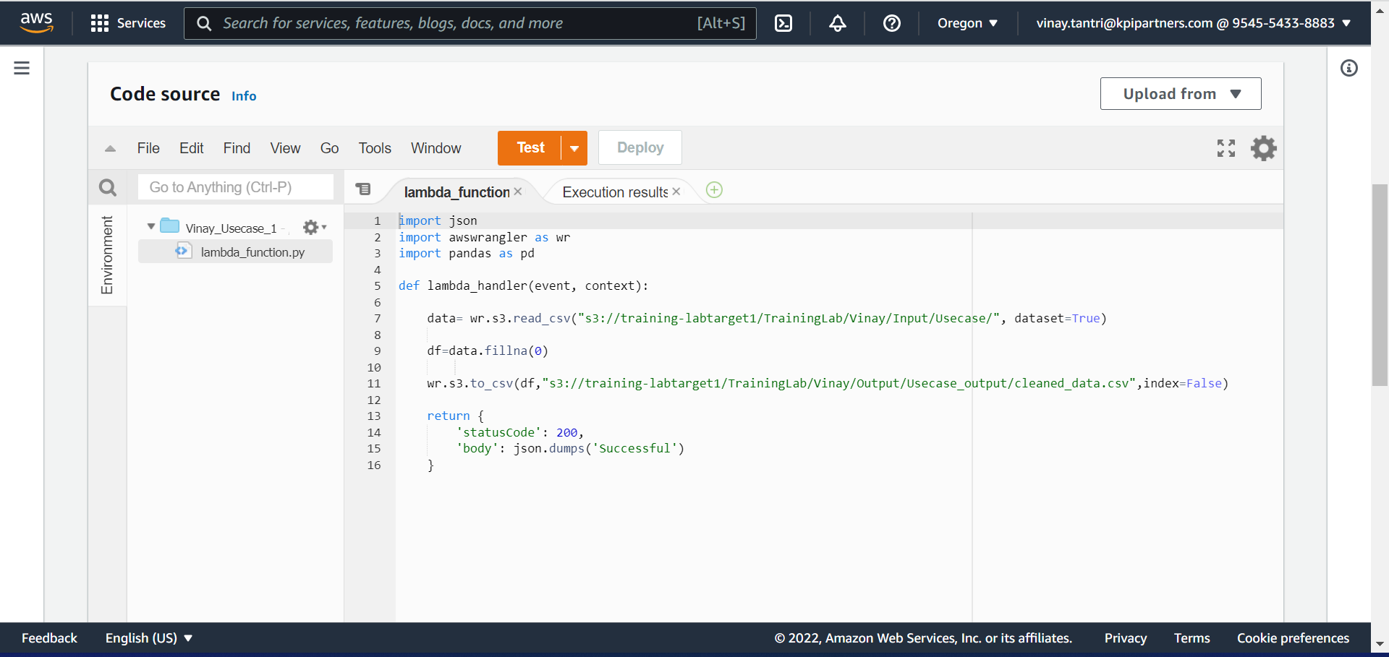
1.Clean and transform data for processing

Slide 5
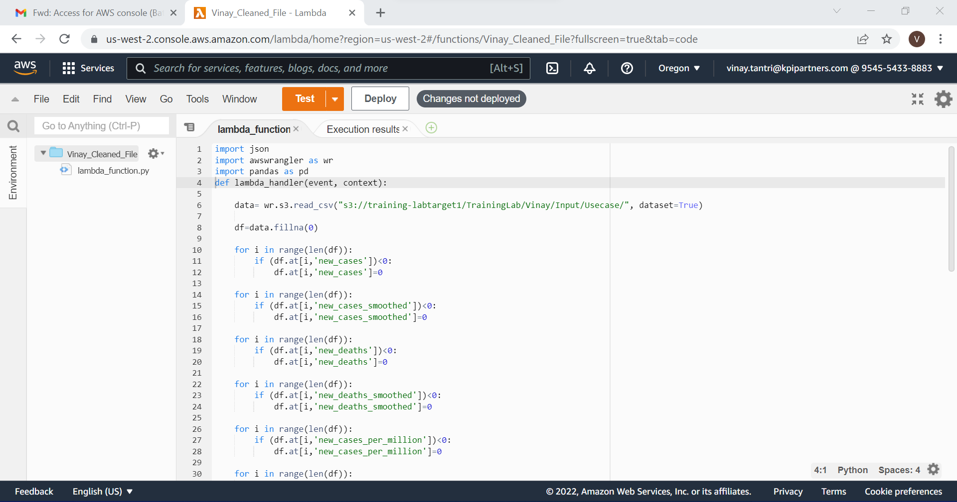
2. ETL operations on dataset

Slide 6
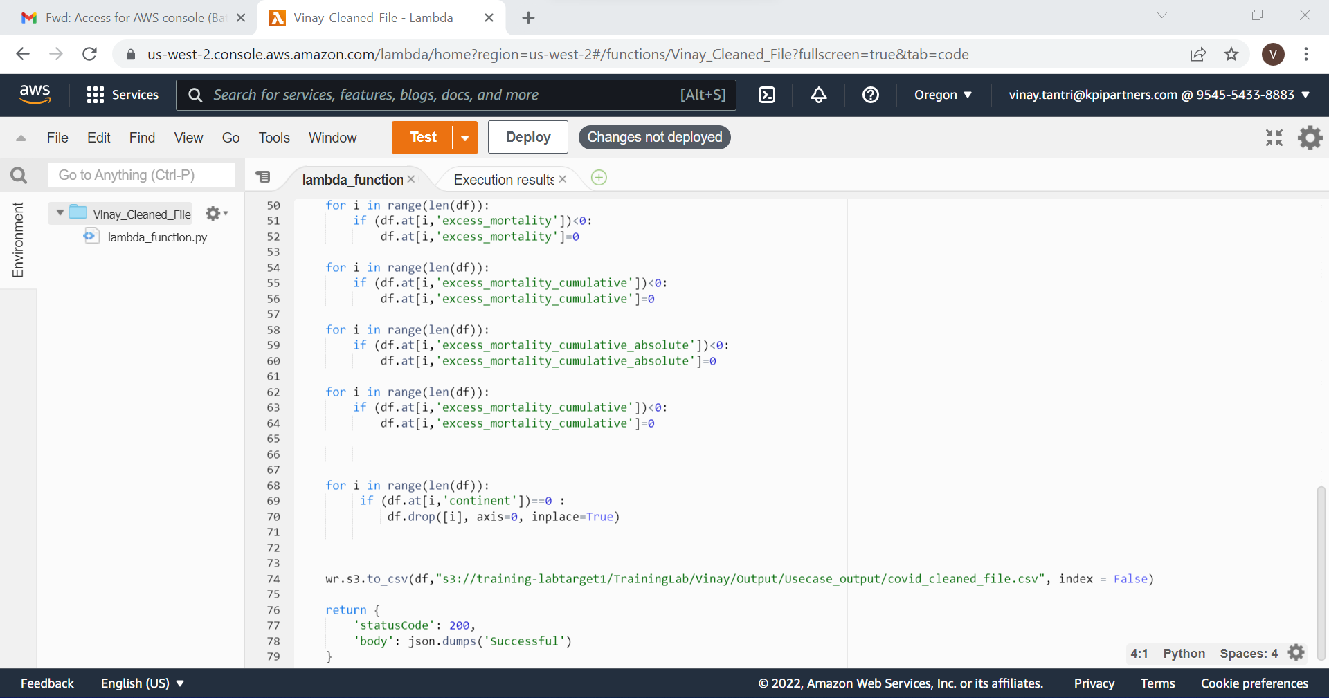
Continue

Slide 7
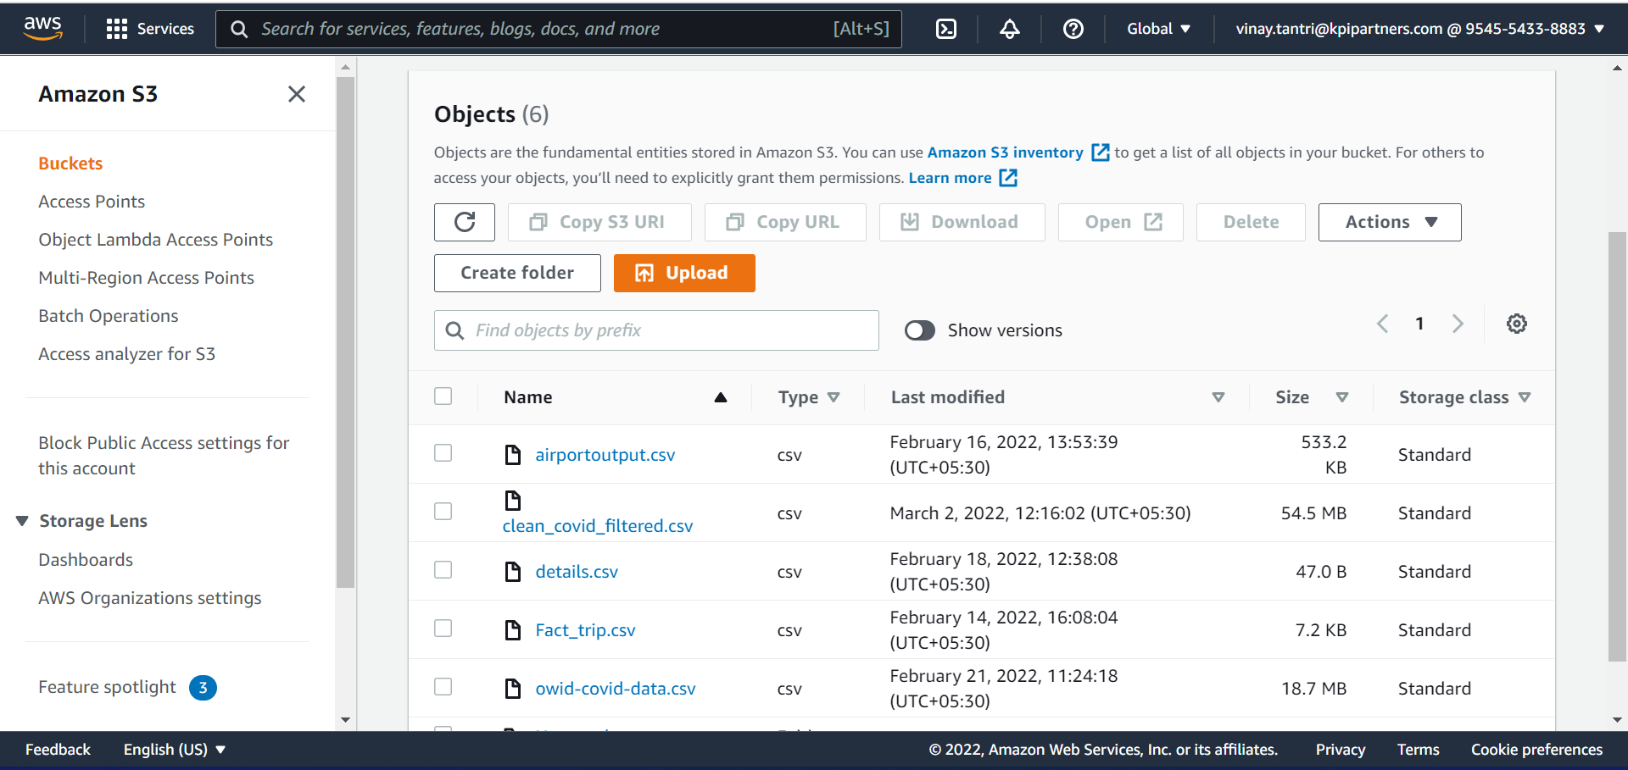
3. Storing the modified data in AWS

Slide 8
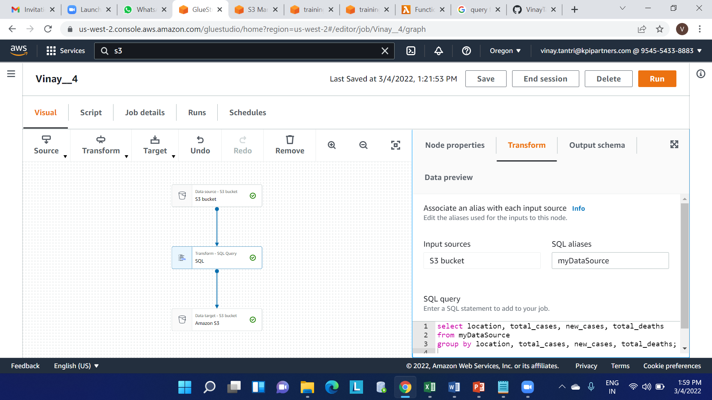
4.Display total cases ,new cases and deaths.

Slide 9
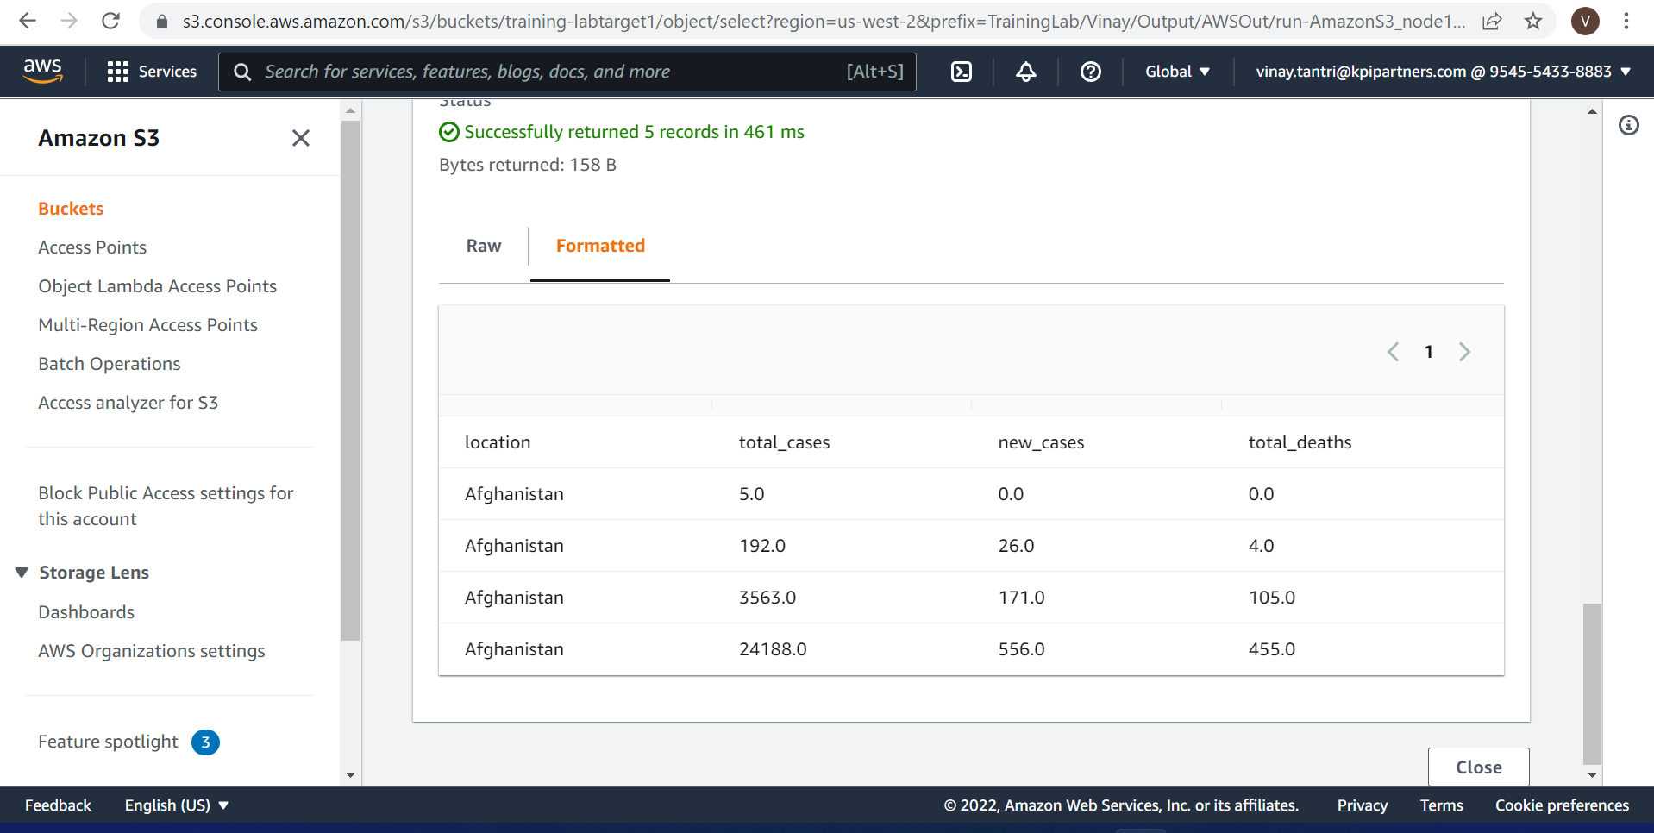
Continue
For full output please click the side icon

Slide 10
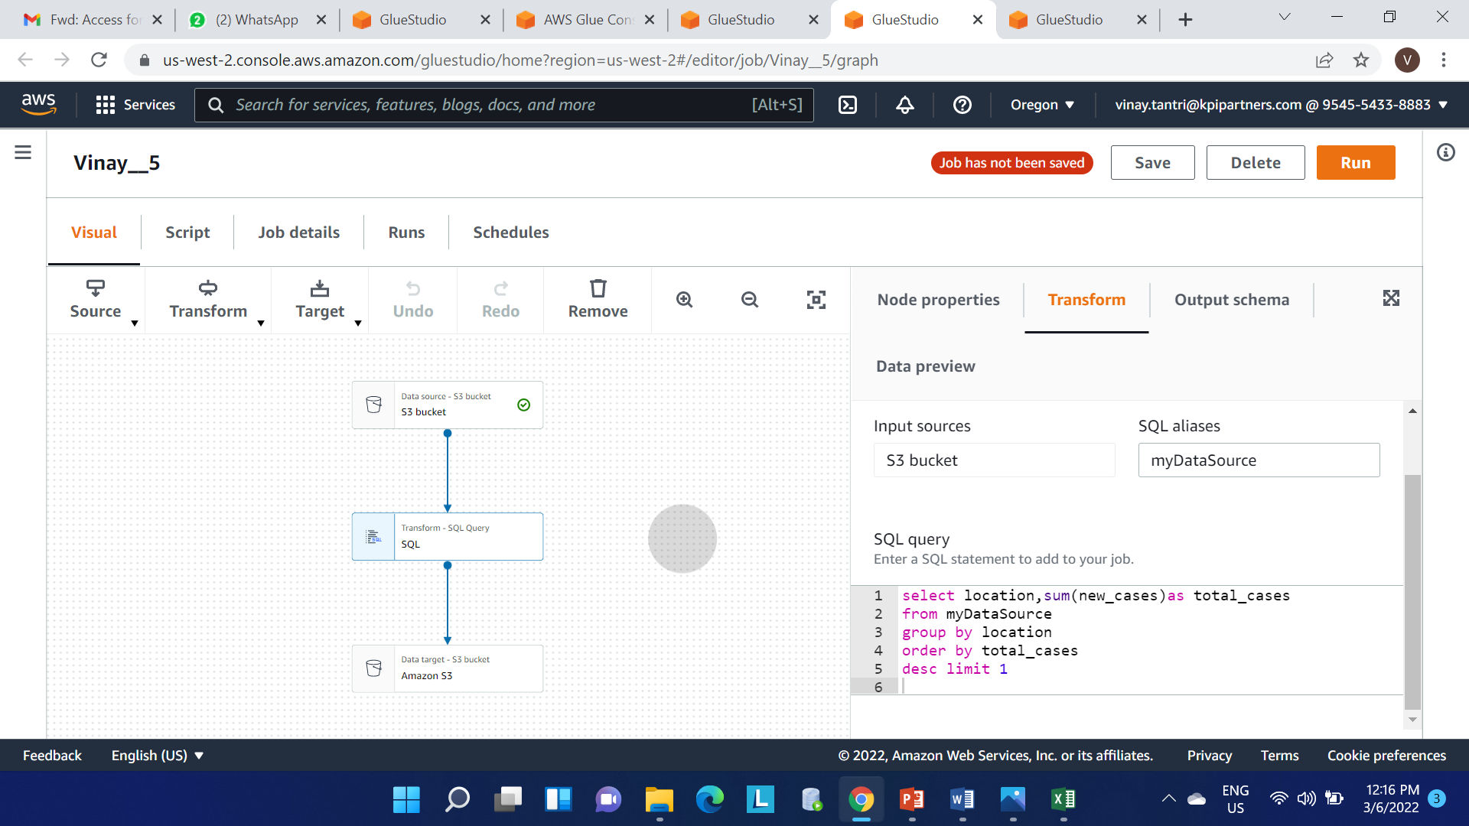
5.Which country in Distinct WHO region highest cases in till date.

Slide 11
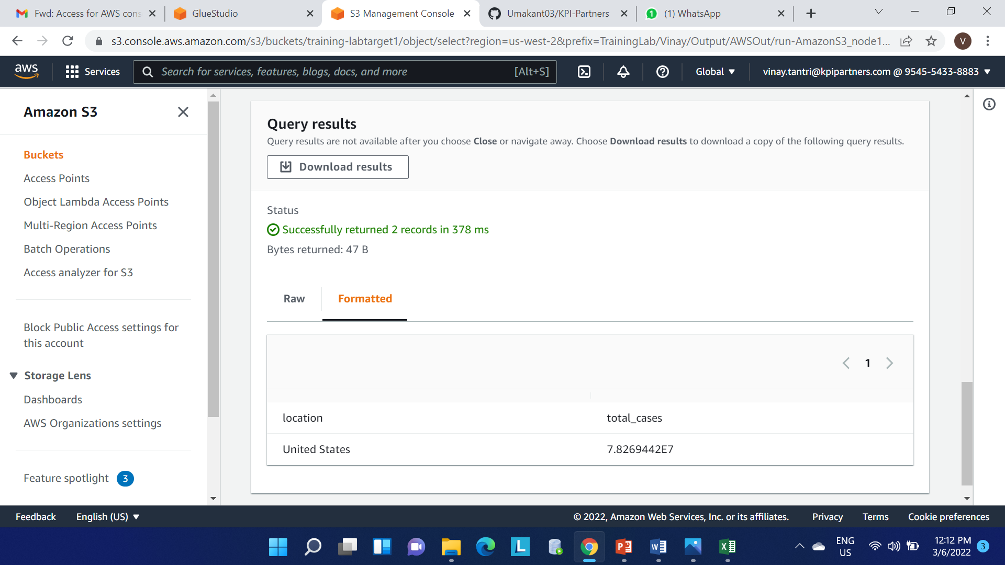
Continue

Slide 12
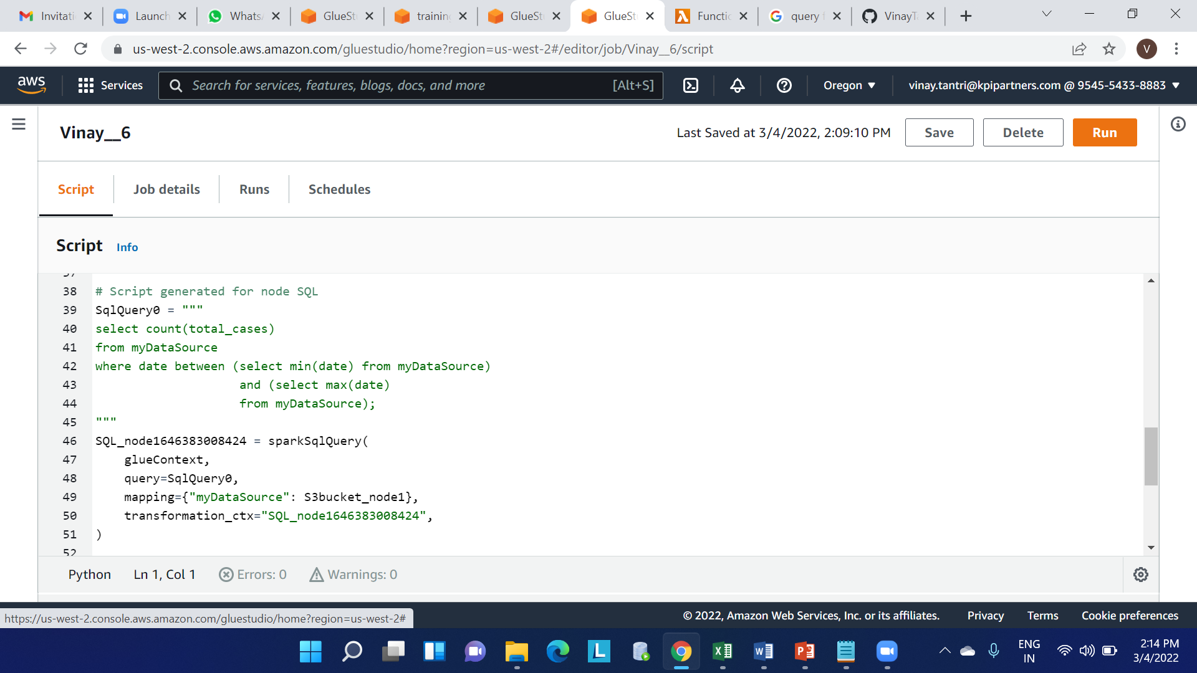
6. Total no of confirmed cases over between a certain date.

Slide 13
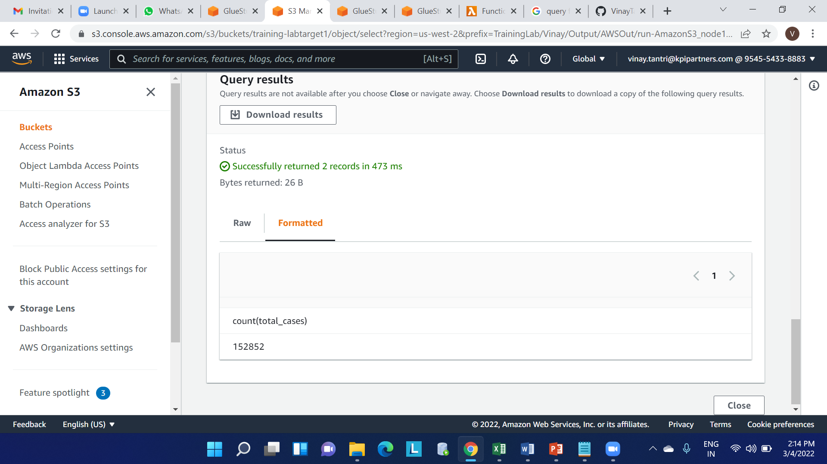
Continue

Slide 14
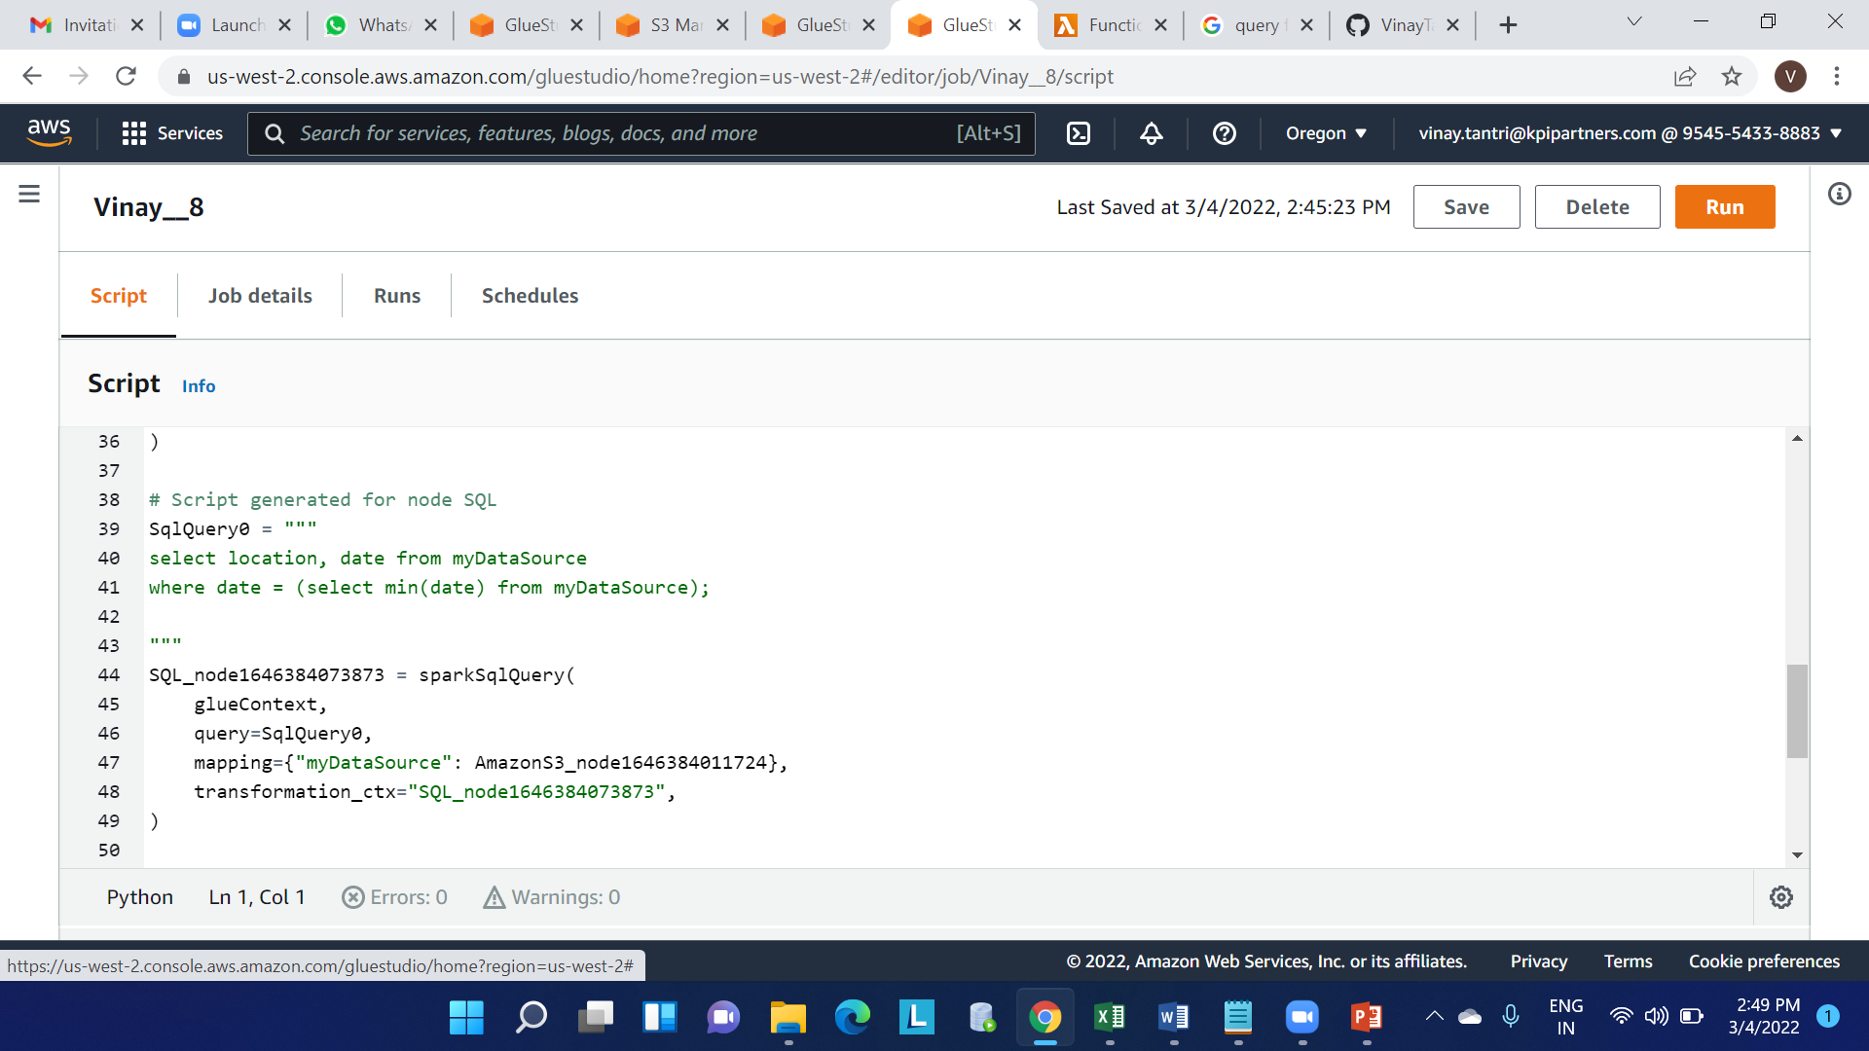
7.Date of first confirmed case in a particular region.

Slide 15
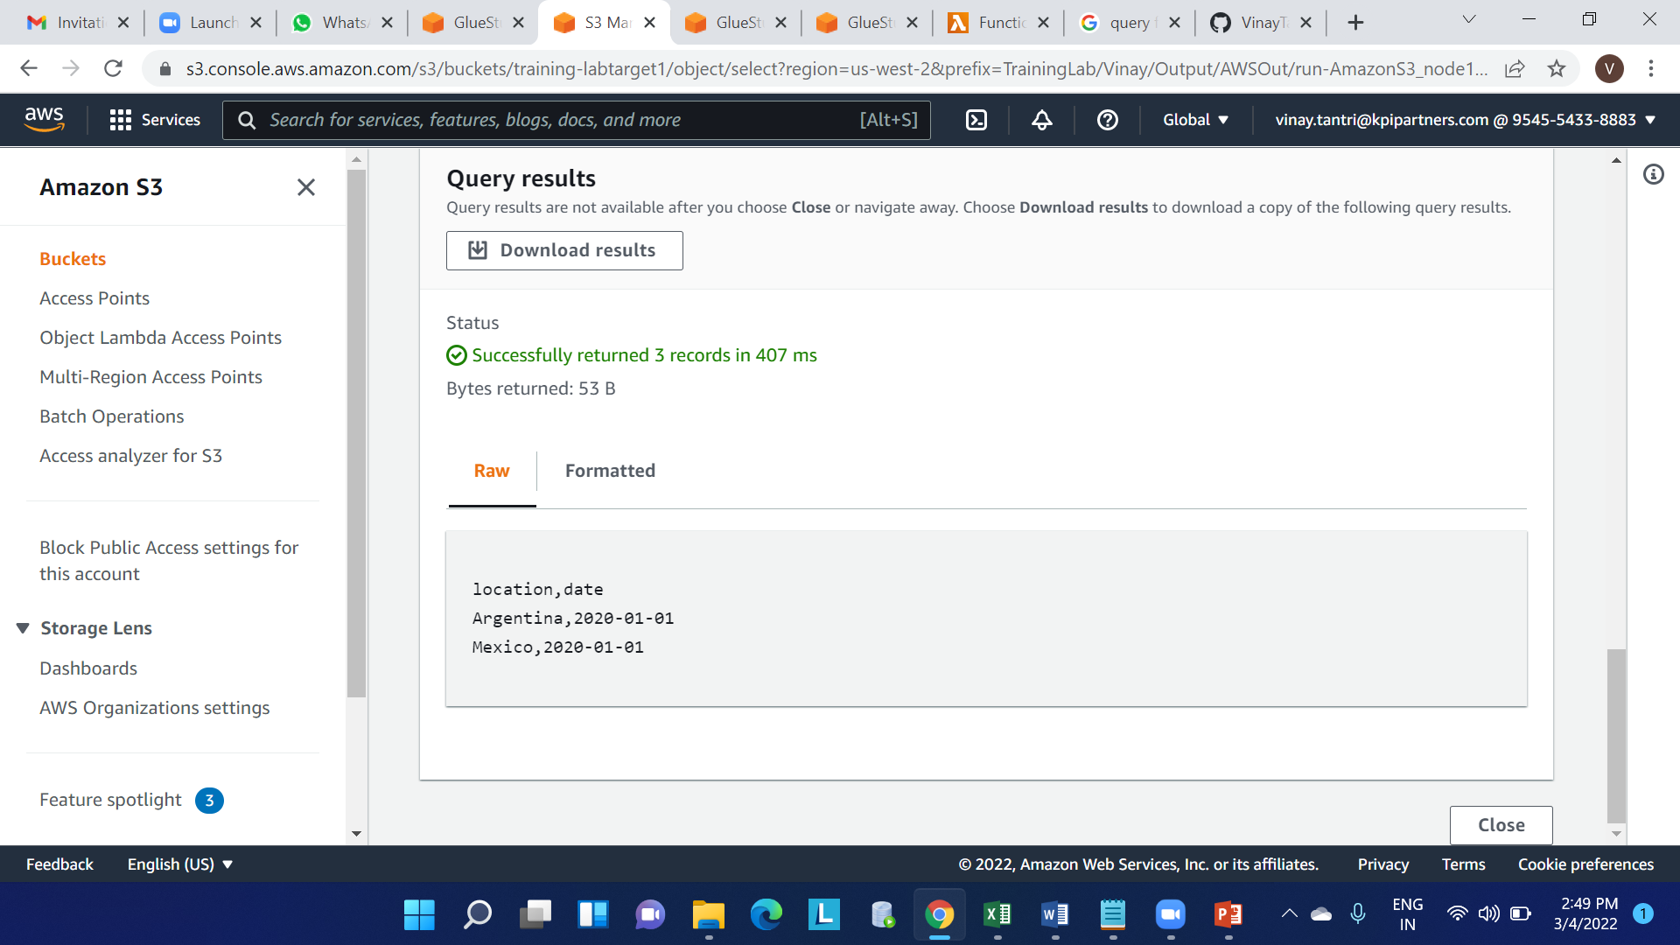
Continue

Slide 16
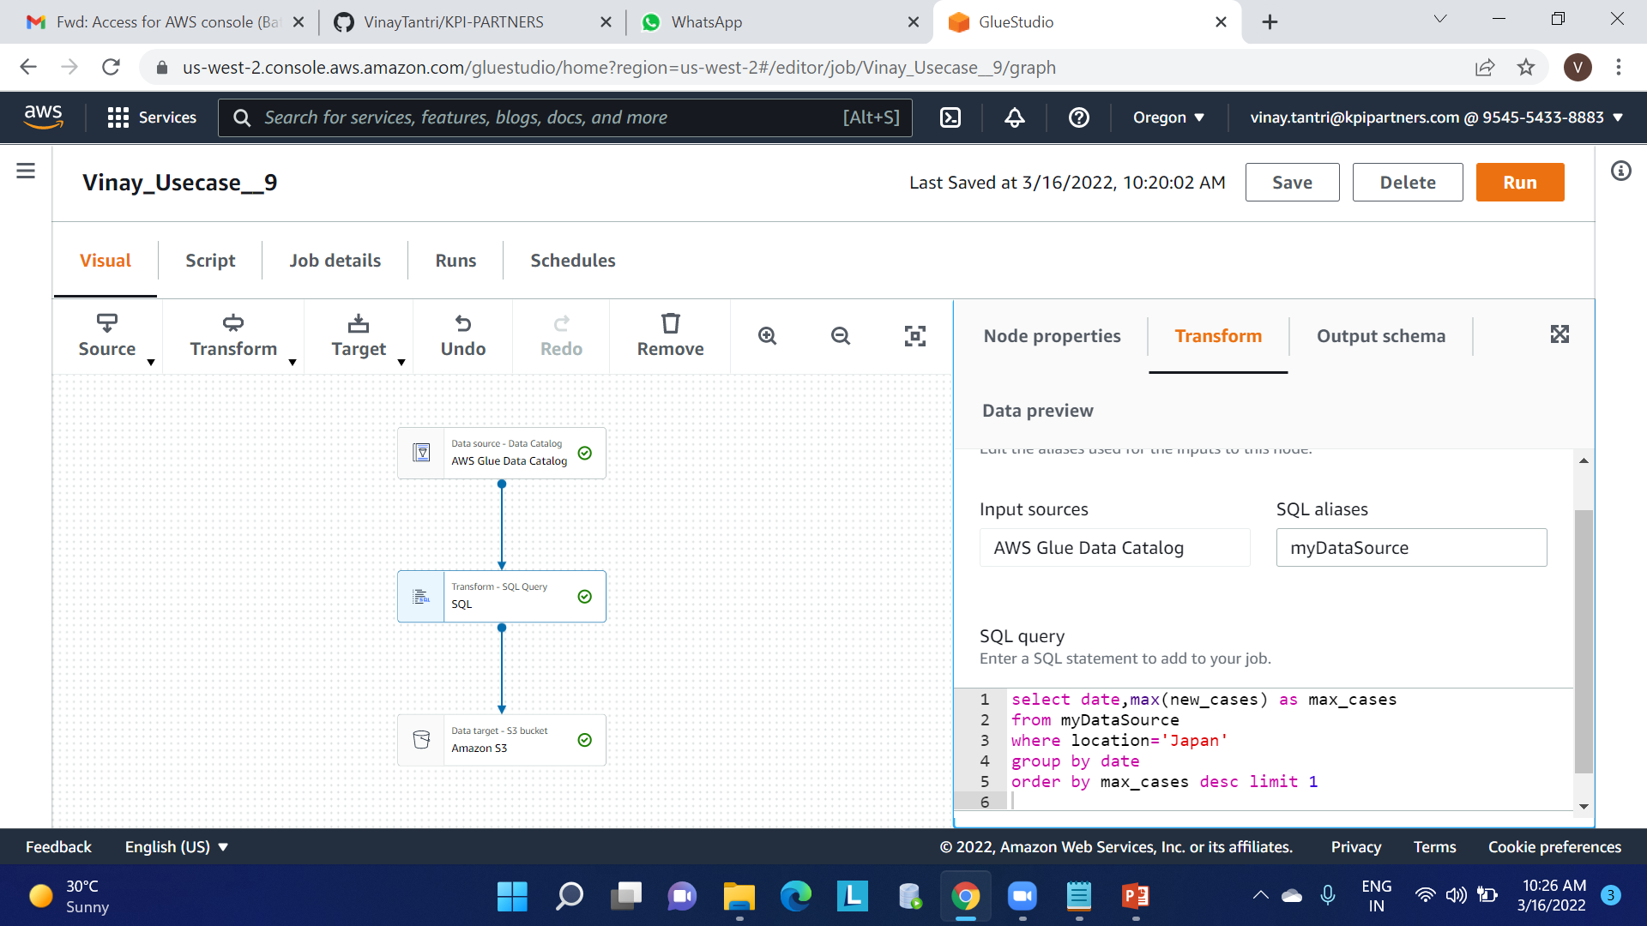
8.Date on which max no. cases were reported in a country.

Slide 17
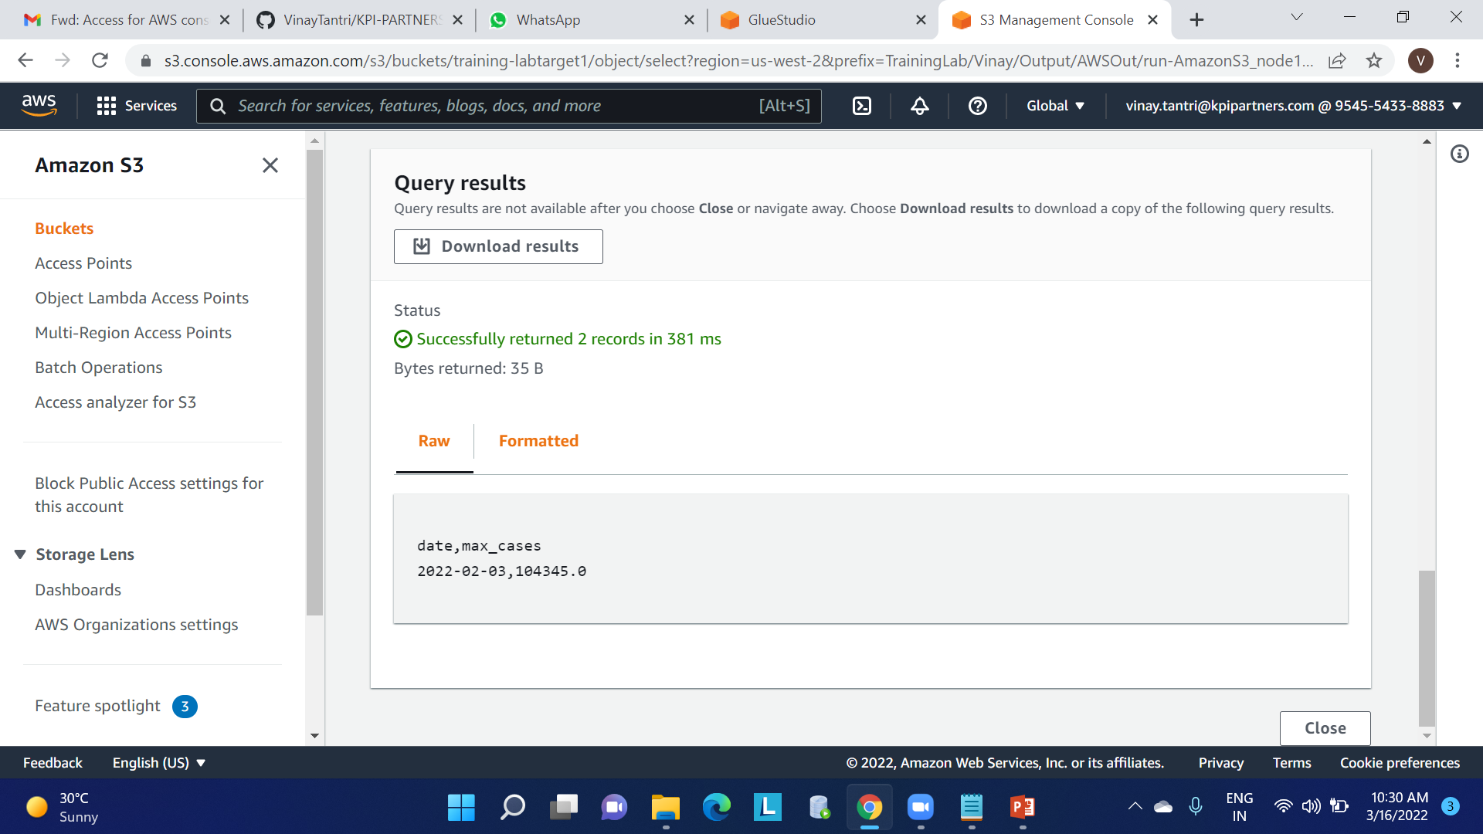
Continue

Slide 18
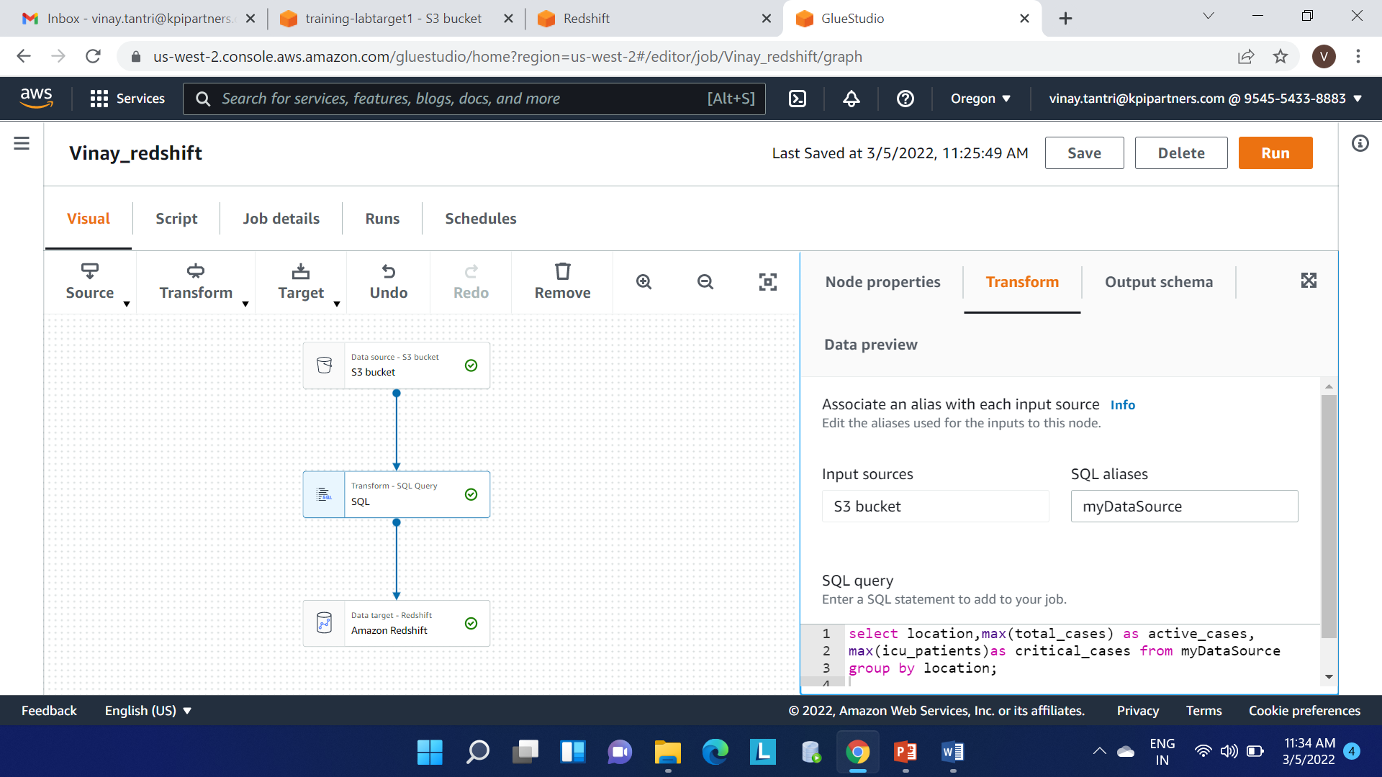
9.No. of active cases vs critical cases of a country.

Slide 19
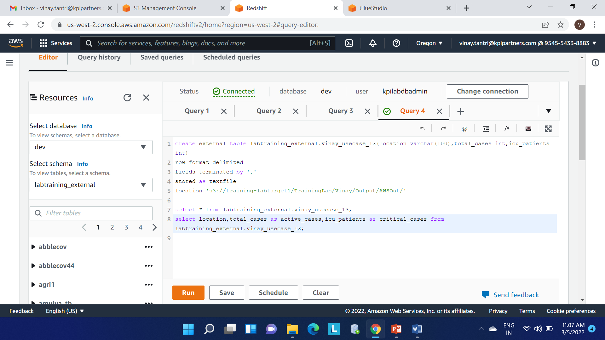
Continue

Slide 20
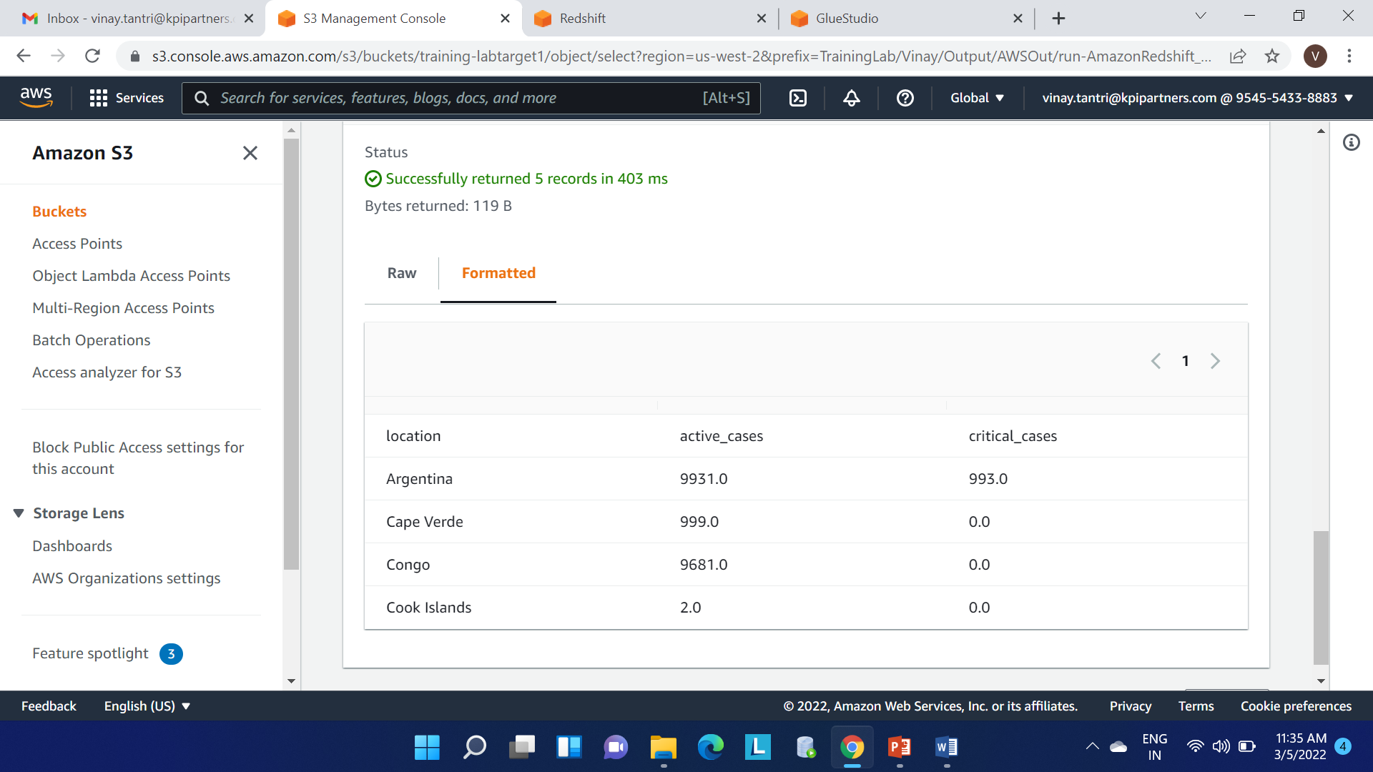
Continue

Slide 21
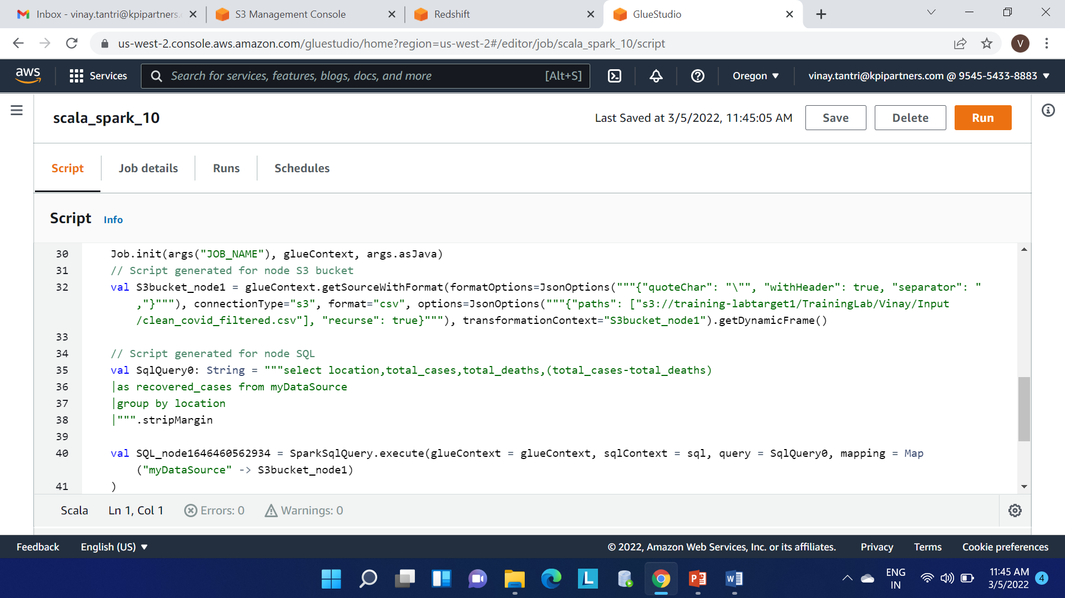
10.Line chart showing total cases, deaths &recoveries of a particular country .

Slide 22
THANK YOU

